Slide 1
Capstone Project
Flight Delay Analysis
California State University, East Bay College of Business and Economics
Team 2:
Fabjola Kasaj
Anjaneya Chowdary Kamepalli
Mandalaparty Deepthi Mounica
INSTRUCTOR
Chongqi (CQ) Wu

Slide 2
Objectives:
Analysis to check the mean arrival delay/departure delay caused by several airlines in the United States.
Analysis to check the monthly performance trends with respect to delays by airlines.
Analysis to check the reason for delays.
Analysis to check the mean delay per airport.
Take-off $ Landing delays.
Analysis for the number of airports visited by each airline.
Analysis for the distribution of departure/arrival delays over the states.
Analysis for the delays varying among years 2010-2020.

Slide 3

Analysis Flow chart:

Slide 4
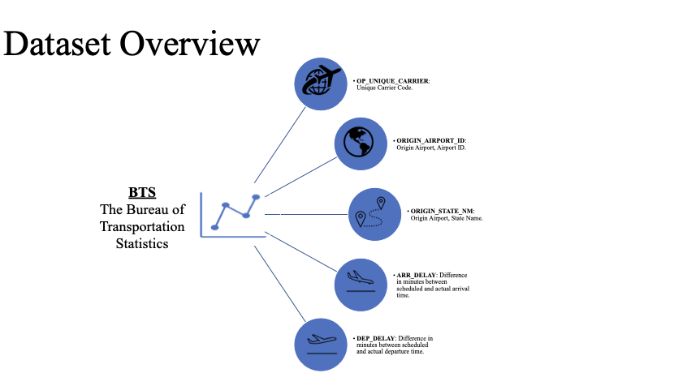

Slide 5
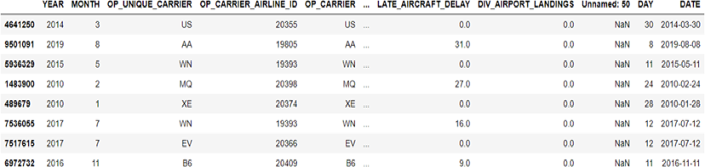
Data Cleaning:
This is a huge dataset with 11,221,080 rows and 52 columns.
Filling factor almost 100%.

Slide 6
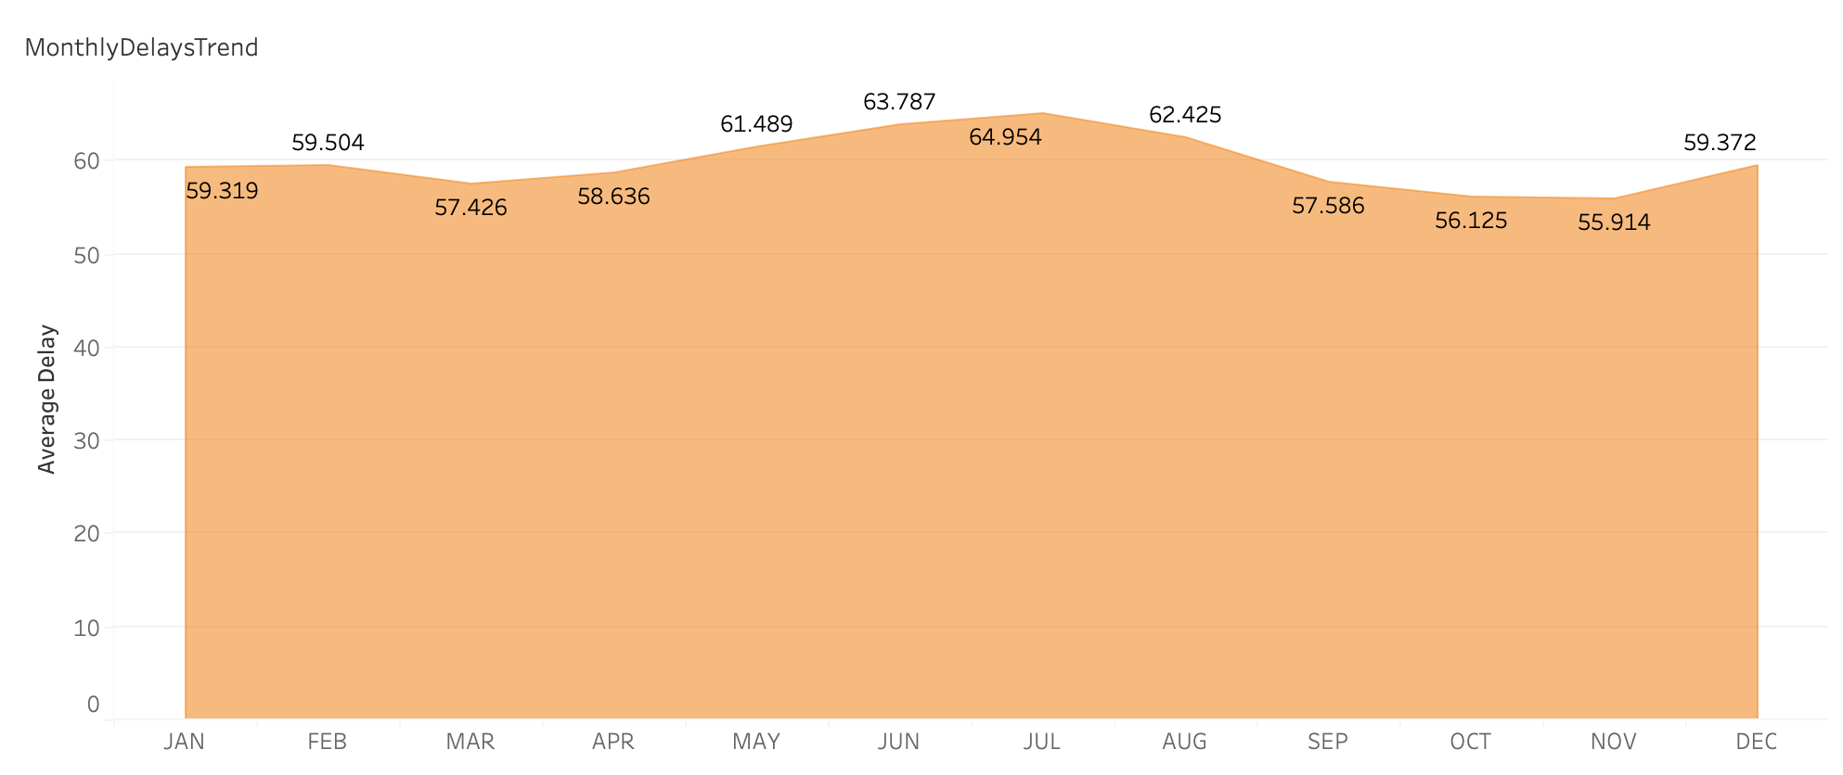
Monthly Delay Trends
The monthly average arrival delay for July is highest with 64.9 minutes and the monthly average arrival delay for November is the least with an average of 55.9 minutes ,compared to all the 12 months.
Hence November is the best time to travel and we can expect delays for sure in the month of July.
June, July and August are the top 3 months with highest delays.
November, October, September and March are the top preferred months to travel with least average delays.

Slide 7
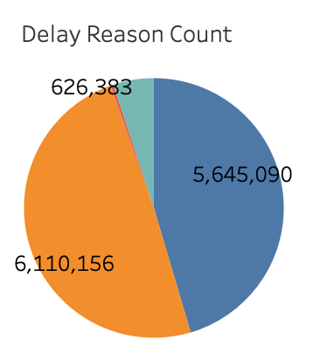
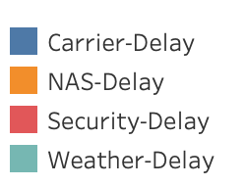
Reasons for Delay
Carrier-Delay
NAS-Delay
Security-Delay
Weather-Delay
NAS-Delay contributes more when compared to all the other reasons of delays in the below pie-chart with almost 50% occupancy.
Hence it is the most frequent reason for flight delays.
Carrier-Delays are the second most frequent reasons for delays.
Security-Delays contributes almost negligible count when compared to all the four reasons of delays.

Slide 8
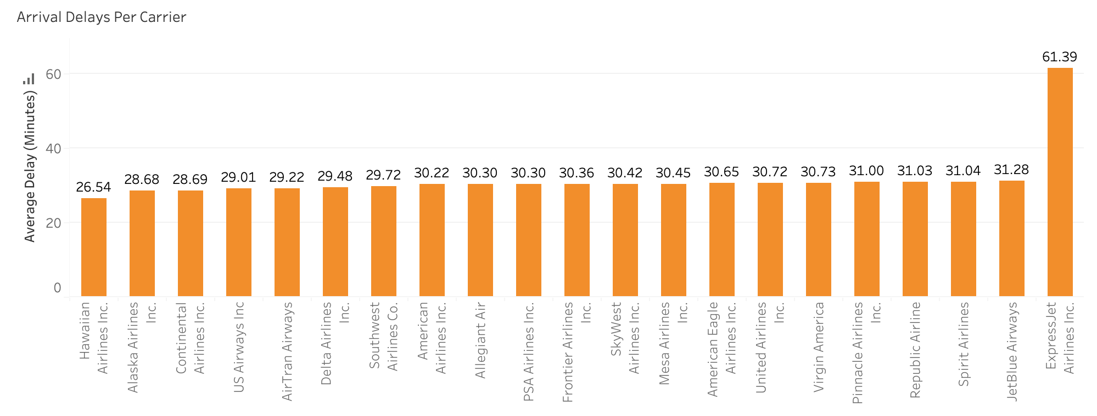
Average Arrival Delays per Carrier
Hawaiian Airlines has the least average arrival delay of 26.5 minutes for the past 10 years of data when compared to all other airlines.
ExpressJet Airlines has the highest average arrival delay of 61.3 minutes when compared to all other airlines.
Almost all the other airlines excluding the above mentioned airlines have an average arrival delay of approximately 30 minutes.

Slide 9
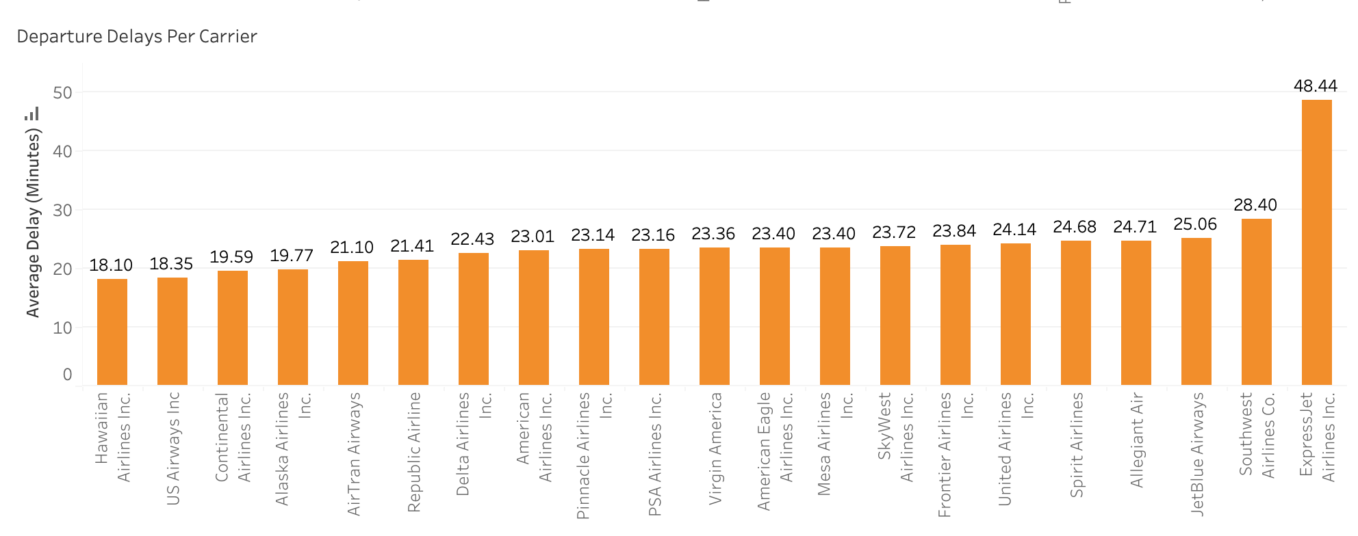
Average Departure Delays per Carrier
Hawaiian Airlines has the least average departure delay of 18.10 minutes.
ExpressJet Airlines has the highest average departure delay of 48.4 minutes for the past 10 years of data.
Almost all the other airlines have an average delay of approximately 20 minutes.

Slide 10
Mean delay per origin airport
The departure delays vary from 46.17 to 72.87 minutes in average. The states with higher arrival delays are North Dakota, South Dakota and Kansas. While states with lower arrival delays are Arizona and Utah.

Slide 11
The interval of arrival delays is 51.19 to 82.89 minutes in average. So, arrival delays seem to be longer departure ones. And the states with higher arrival delays are West Virginia, Kansas and North Dakota.

Slide 12
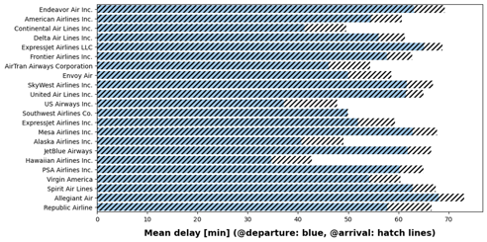
Take-off Vs Landing delays
Delays at arrival are generally lower than at departure. This indicates that airlines adjust their flight speed in order to reduce the delays at arrival.

Slide 13
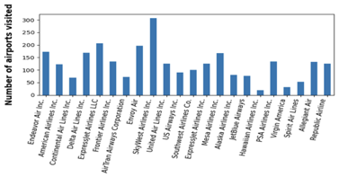
Count of airports visited by each airline
In total we have 389 different airports in our dataset. Based on that, the graph shows the distribution of flights every airline company took in those airports.
From this graph we can notice that SkyWest Airlines, ExpressJet Airlines and Endeavor Air are the three companies with the largest flight numbers within the last 10 years.

Slide 14
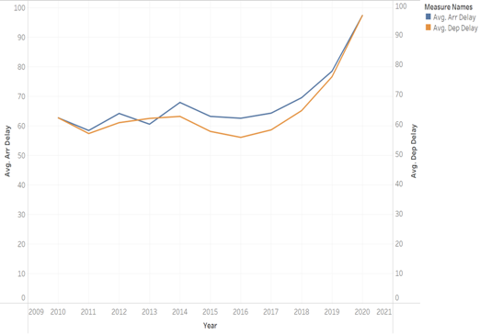
Delays among years
Observing the results overall there is a general tendency of having higher average arrival delays than departure delays in most of the cases.

Slide 15


Slide 16
THANK YOU

